Slide 1
Video Summarization Tool
By Justin Ho

Slide 2
About Me
Justin Ho
Graduated in University of Illinois
B.S. Actuarial Science
Background in Post Production, working on Unscripted Shows for Cable Networks like Discovery, Animal Planet, Travel Channel handling footage and editing

Slide 3
Project Motivation
Transcription and Logging is a huge part of the industry.
Using data science to extract meaningful content from interview footage

Slide 4
Assembling Pipeline
Youtube-DL → MoviePy → S3 → AWS Transcribe → Data Science → SQL → MoviePy → Flask

Slide 5
Data Science Tools
NLP TF-IDF
After cleaning up the transcript, I took the most common words from each sentence (TF) and measured how rare the word compared to each document (IDF).
TF-IDF to find the most meaningful words.
Bias towards longer sentences.

Slide 6
Lessons Learned
Duration & Word Count Difference 40-60%
Jump Cuts
Creating Presentable and Organized Code
Showcasing the end product.
Inputs, Outputs, Visualizations.

Slide 7
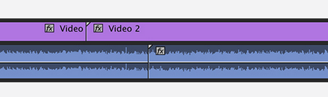
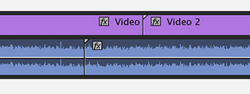
Improvements on modeling
Creating a model that can recognizing speech inflections and visual J-L cuts.
L-Cut J-Cut
Recognizing B-roll

Slide 8
Should I show a video?
Thank You!

